Slide 1


END SEMESTER PROJECT
E Commerce Application
Presented by:
Ahmar Kamran
Saif Sheikh
Zainab Athar

Slide 2
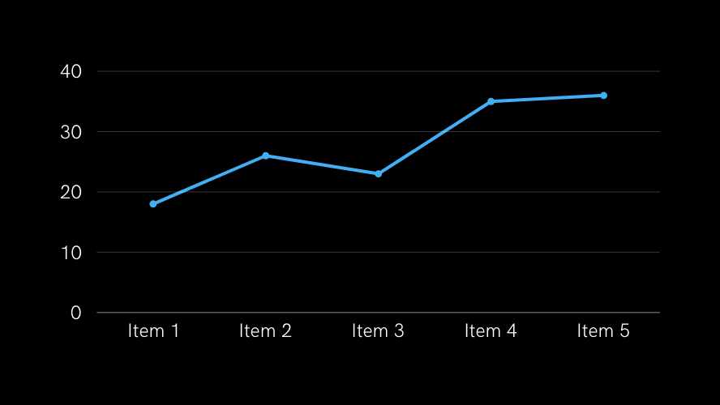
What is Shopi?
$100,000
Shopi is a web-based shopping application designed for rural women entrepreneurs to sell their products online.
Features:
Easy-to-use interface tailored for non-technical users.
Secure payment gateway and order management system.
Product listing, categorization, and search functionalities.

Slide 3



STAKEHOLDERS
Business Owners / Entrepreneurs
Customers
Rural women Entrepreneurs
Website Developers (Frontend and Backend)
Logistics and Shipping Partners

Slide 4
A PHP framework that simplifies web application development with elegant syntax and built-in features like routing and ORM.
Laravel - PHP Framework
01
TECH STACK
PHP - Server-side Language
A server-side scripting language designed for creating dynamic web pages and applications.
02
An open-source relational database management system used for storing and managing data in web applications.
MySQL - (RDBMS)
03

Slide 5
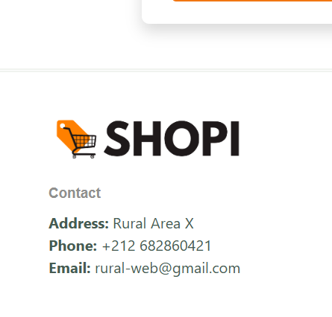
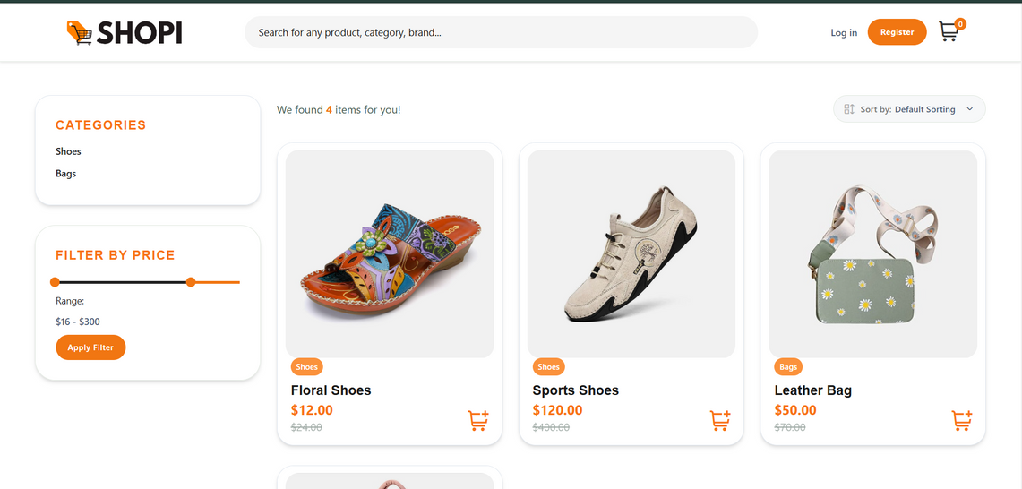
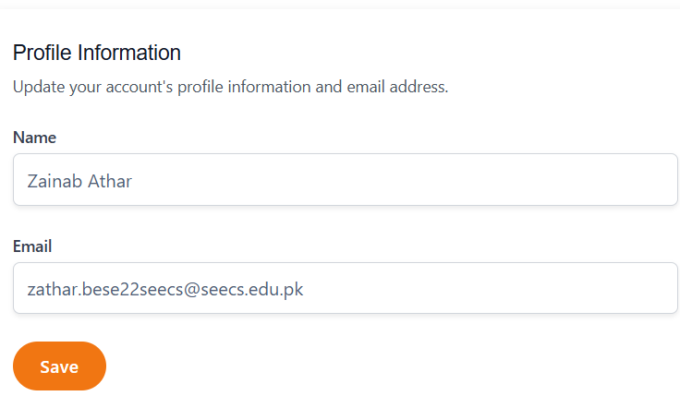

WEBSITE PREVIEW
E-Commerce Website

Slide 6
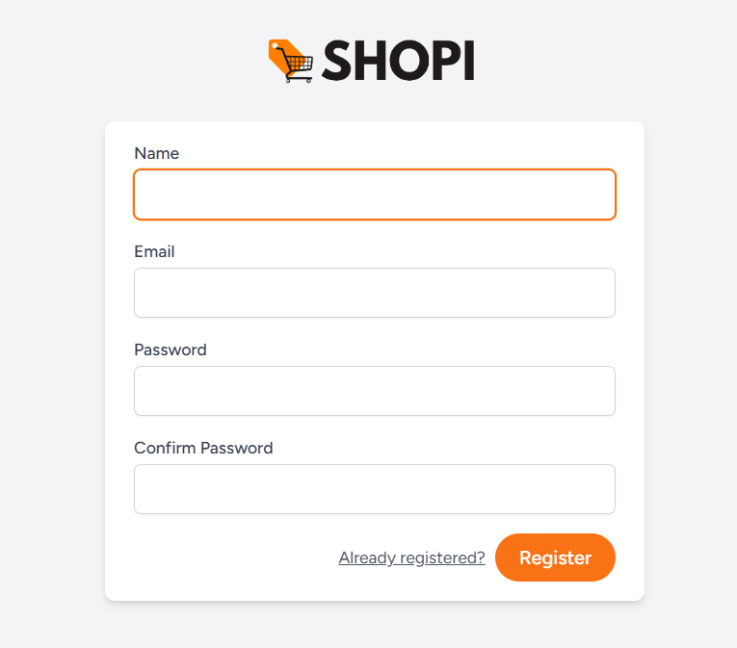
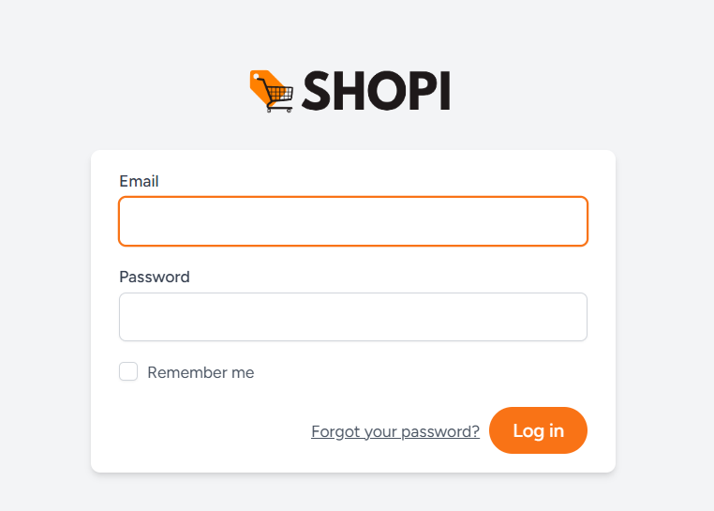
Login
Register

Slide 7
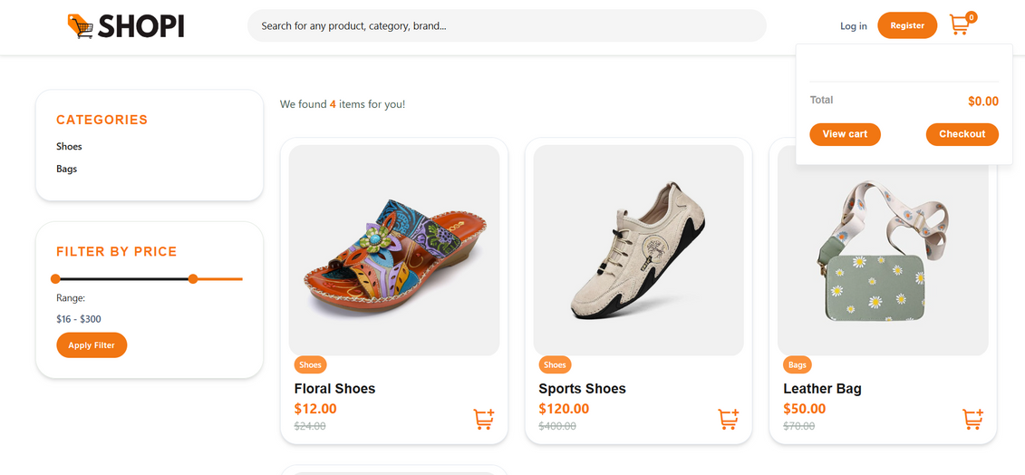
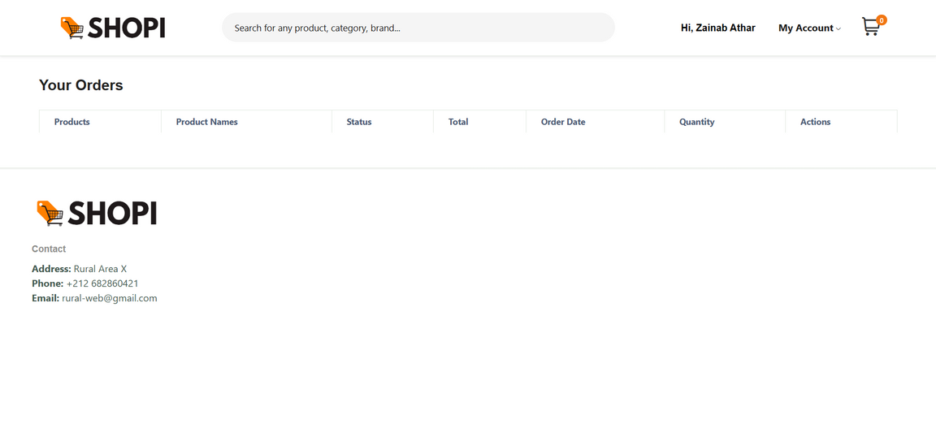
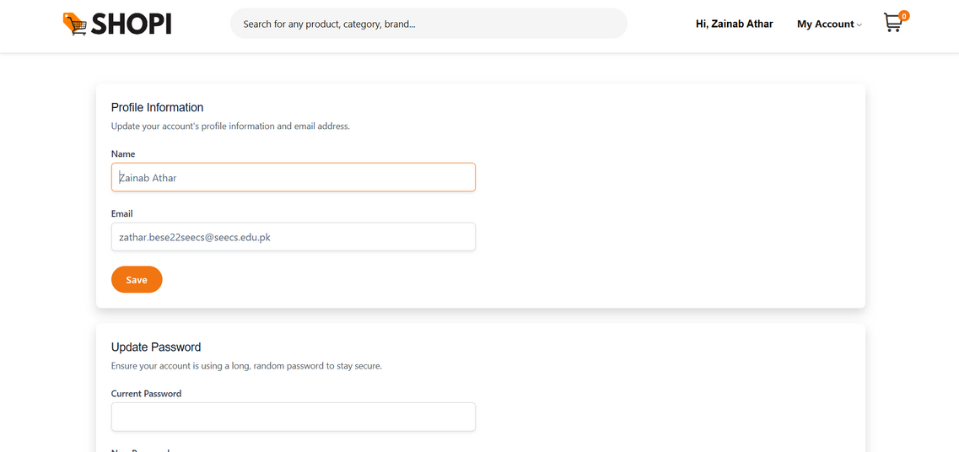
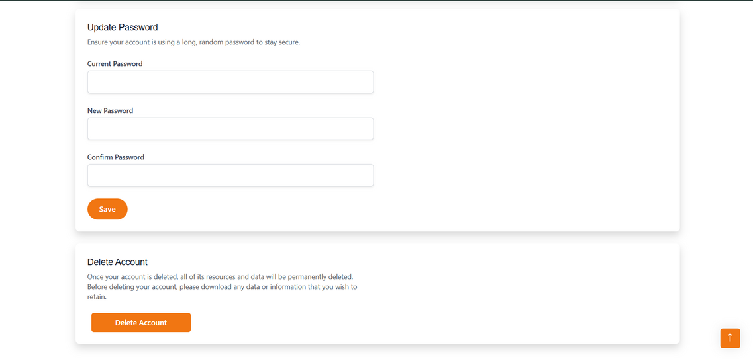
USER DASHBOARD

Slide 8
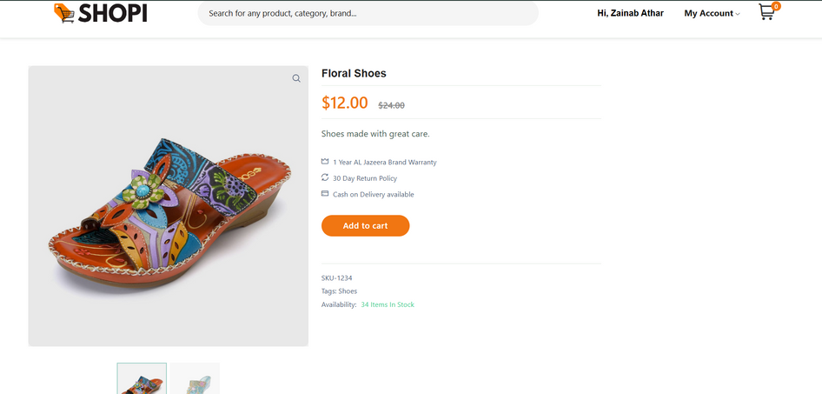
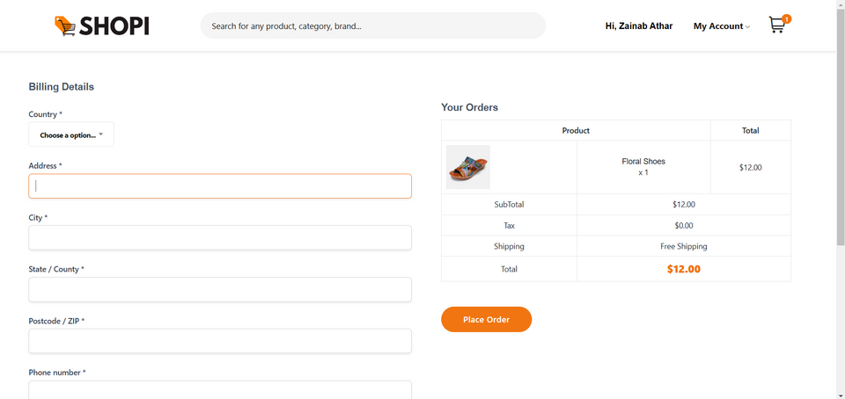
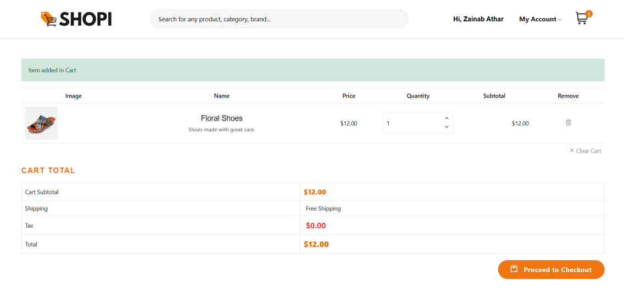
PRODUCT PREVIEW
CHECKOUT
CART

Slide 9
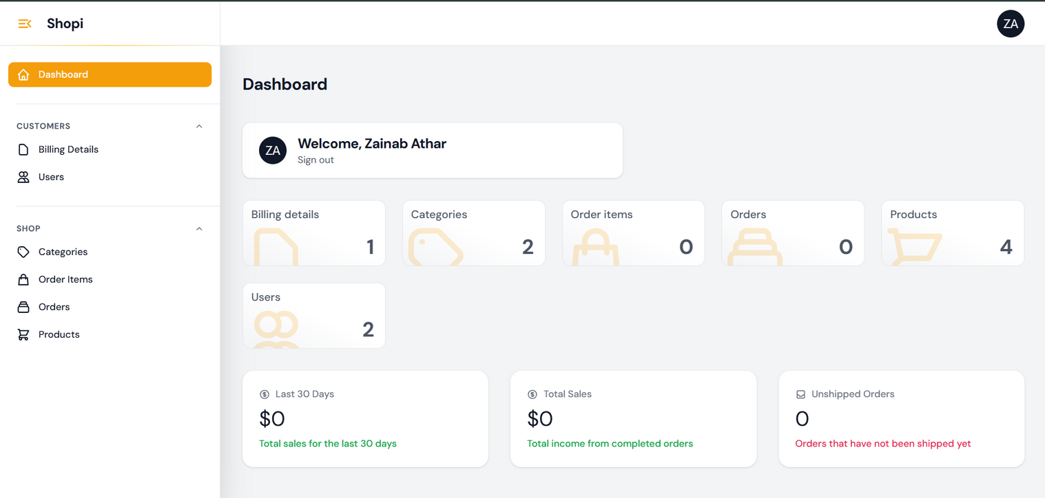
ADMIN DASHBOARD

Slide 10
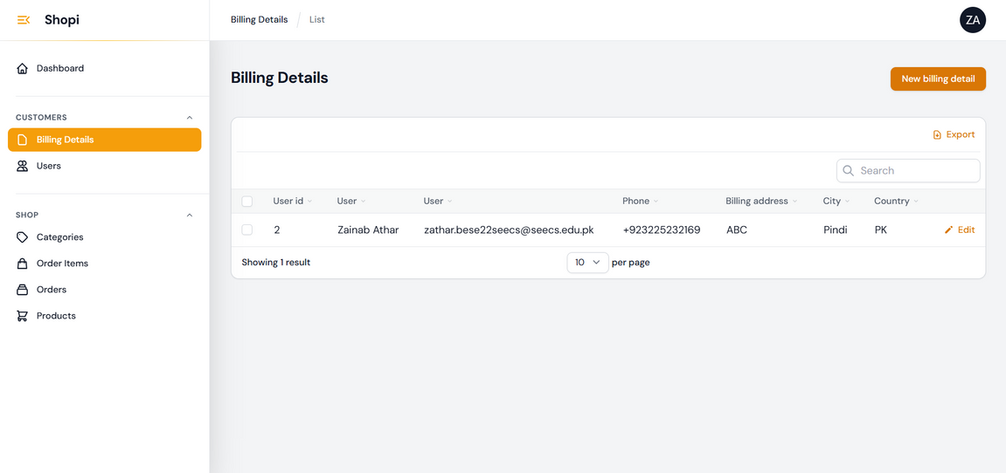
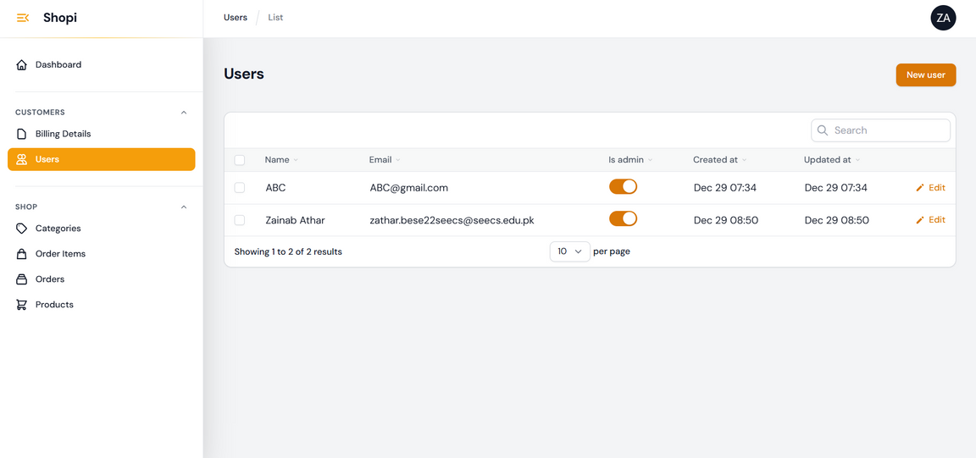
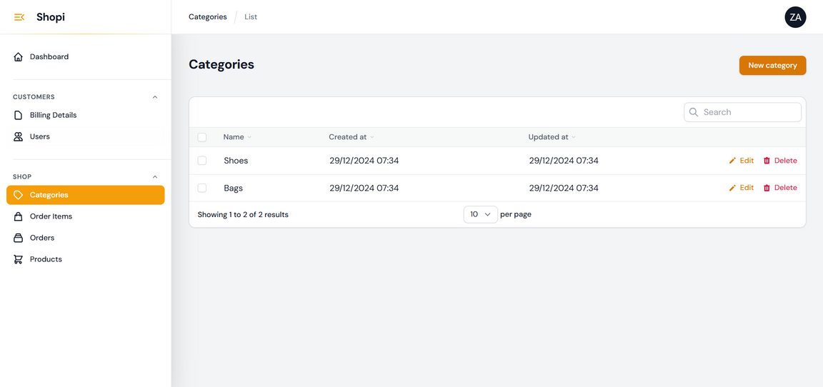
BILLING DETAILS
USERS/ADMIN CONTROL
CATEGORIES

Slide 11
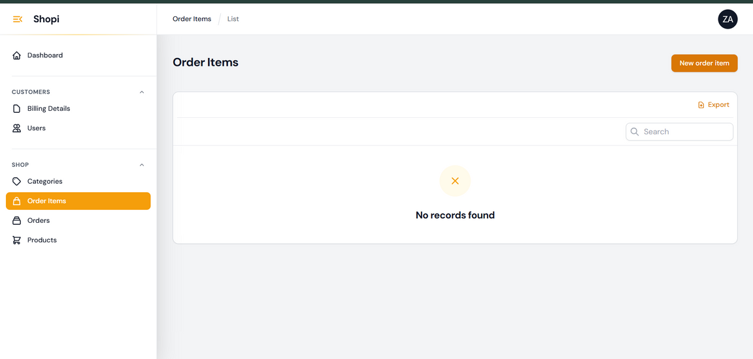
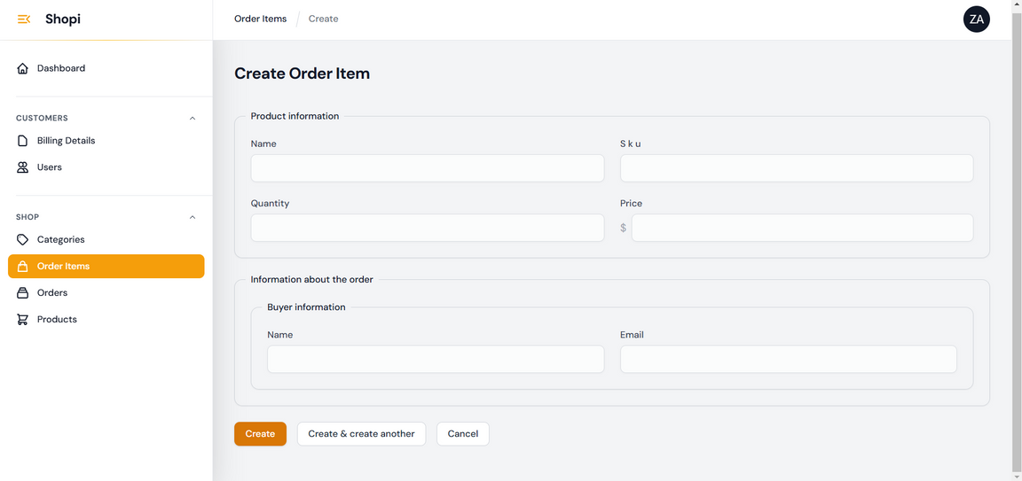
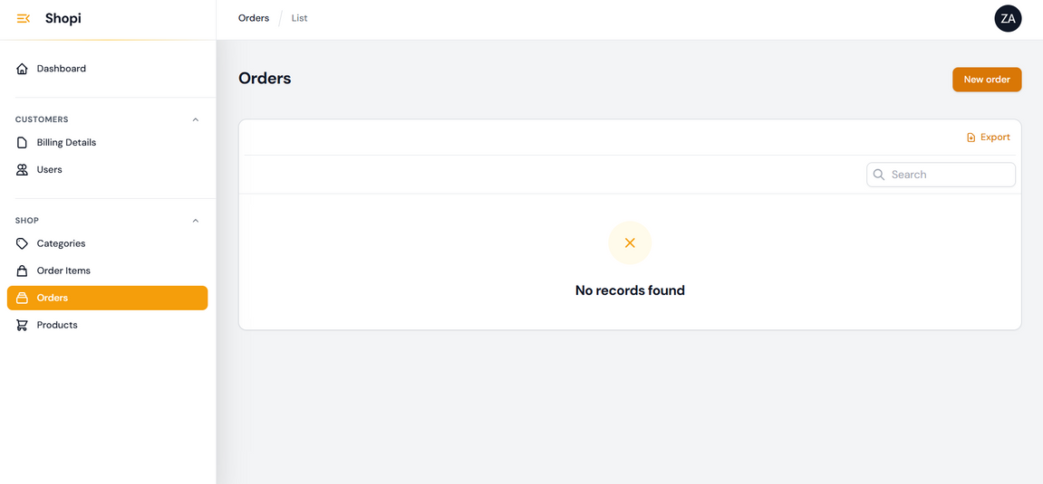
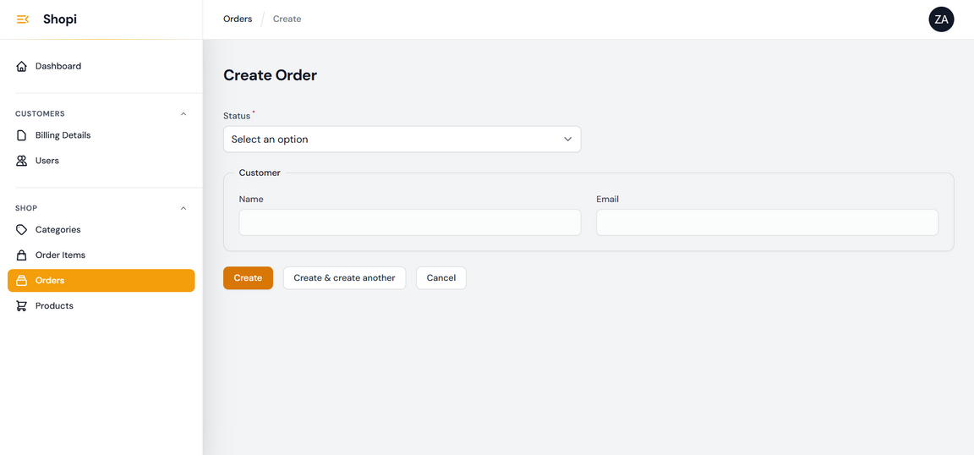
ORDER ITEMS
ORDERS

Slide 12
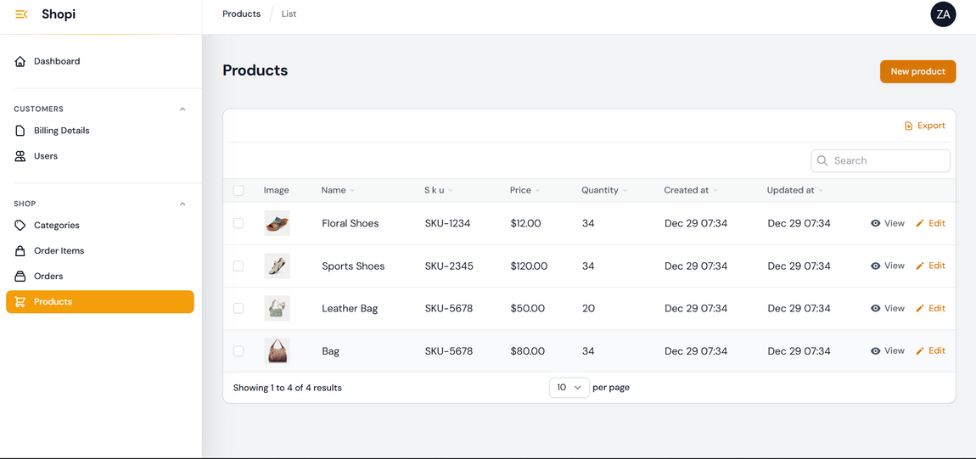
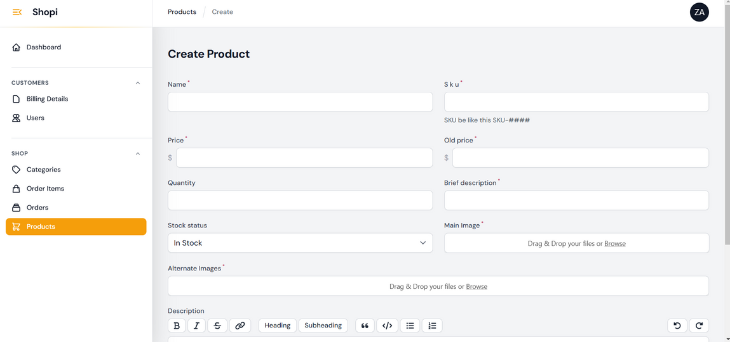
PRODUCTS

Slide 13
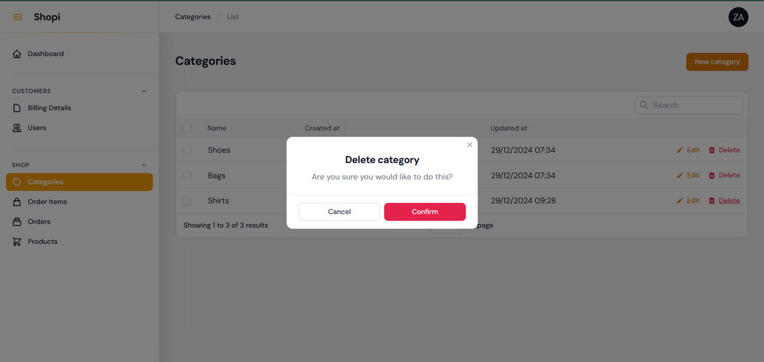
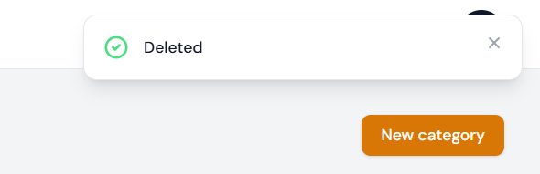
ACTION CONFIRMATION

Slide 14
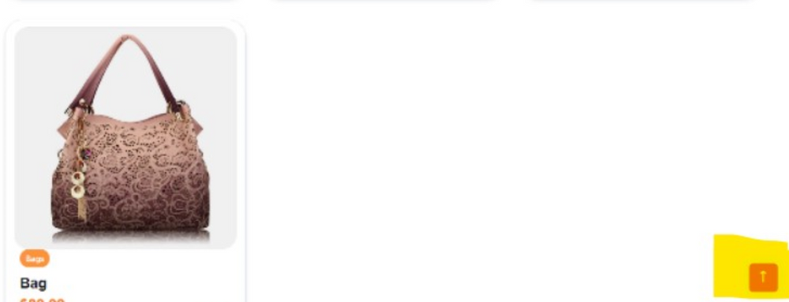
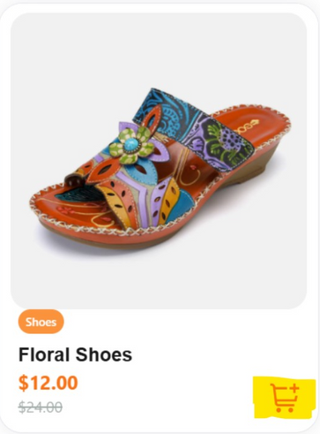
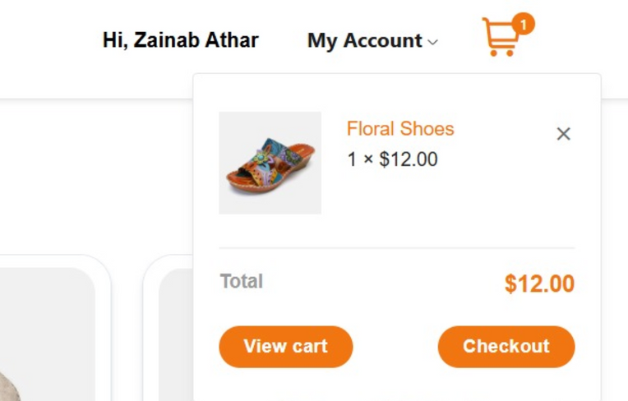
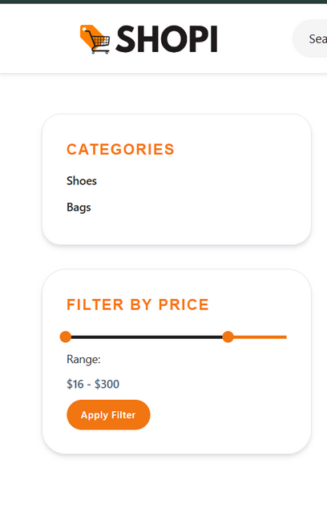
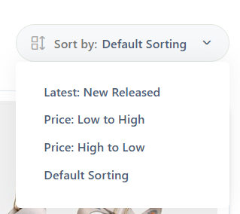
USER CONVENIENCE
Easy Scroll up
Direct Addition to Cart
View your cart directly
Filtering
Sorting

Slide 15
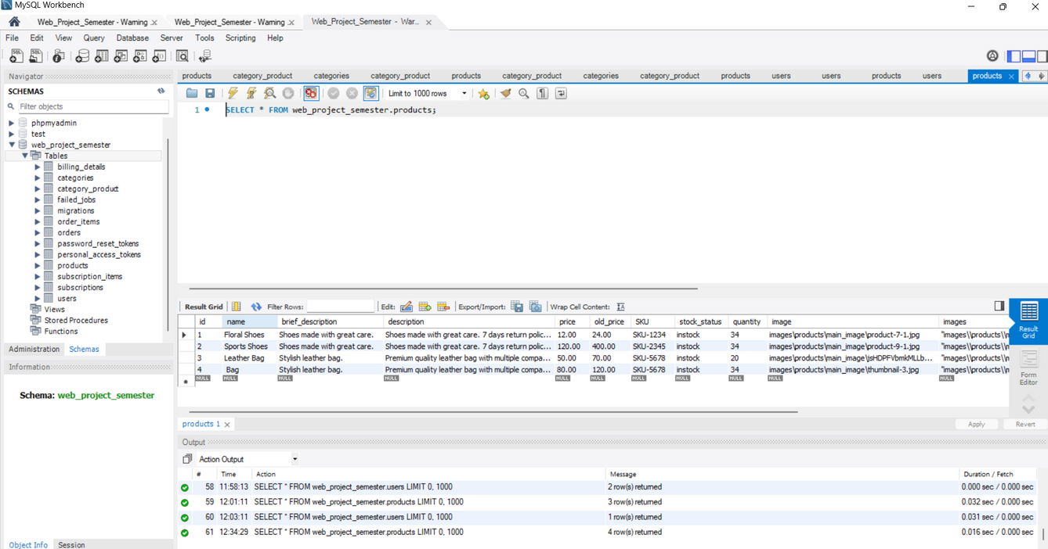
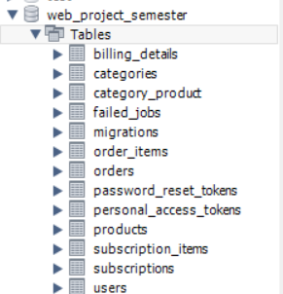
DATABASE

Slide 16
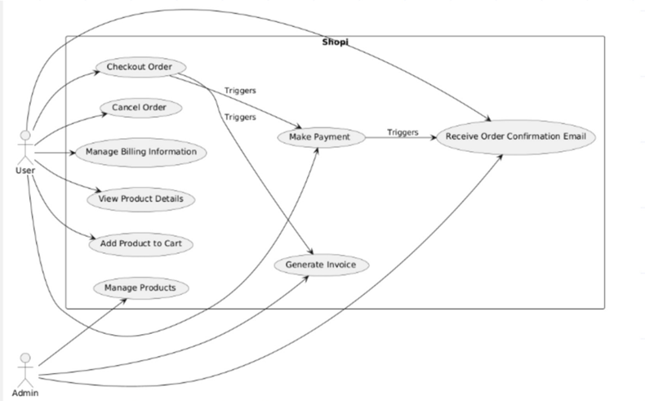
Usecase Diagram

Slide 17
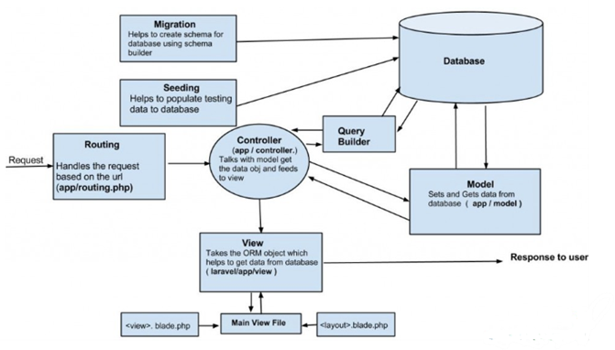
ARCHITECTURE

Slide 18
THANK YOU

